Slide 1
CMSC201 Computer Science I for Majors Lecture 14 – Lists (Continued)

Slide 2
Last Class We Covered
The tuple data structure
Creation, conversion, slicing, traversal
Casting variables
The membership “in” operator
#TBT
Infinite while loops

Slide 3
Any Questions from Last Time?

Slide 4
Today’s Objectives
To review what we know about lists already
To learn more about lists in Python
To understand two-dimensional lists
(And more dimensions!)
To practice passing lists to functions
To learn about mutability and its uses

Slide 5
List Review

Slide 6
Previously Seen Operations
Many of the operations we saw on strings are possible with lists
Which of the following works with lists?
Concatenation (+)
Indexing
Slicing
.lower() and .upper()
len()

Slide 7
Concatenation
Concatenation does work on lists!
But it has the same limit as string concatenation
You can only concatenate lists with lists
So this works:
bookList + supplyList
But this doesn’t:
animalList + "horse"
animalList + ["horse"]

Slide 8
Indexing
Indexing does work on lists!
In the exact same way it does for strings
Some examples:
studentNames[16]
courseTitles[len(courseTitles) - 4]
songList[FAV_INDEX]

Slide 9
Slicing
Slicing does work on lists!
In the exact same way it does for strings
Slicing goes “up to but not including” the end of the slice
>>> stuff = [17, "A", -22, True, "Hello"]
>>> print( stuff[2:4] )
[-22, True]

Slide 10
.lower() and .upper()
These operations do not work on lists!
They don’t make sense for a list
In the same way, .append() and .remove() don’t work on strings
If you try, you get an error about attributes:
AttributeError: 'str' object has no attribute 'remove'

Slide 11
len()
Calling len() does work on lists!
In the exact same way it does for strings
Returns the length of the list
In other words, the number of elements

Slide 12
Two-Dimensional Lists

Slide 13
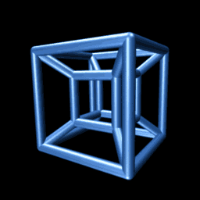
Two-Dimensional Lists
Lists can hold any type (int, string, float, etc.)
This means they can also hold another list
We’ve looked at lists as being one-dimensional
But lists can also be two- (or three- or four- or five-, etc.) dimensional!
Image from wikimedia.org
Notes:
https://commons.wikimedia.org/wiki/File:Tesseract.gif

Slide 14
Two-Dimensional Lists: A Grid
It may help to think of 2D lists as a grid
twoD = [ [1,2,3], [4,5,6], [7,8,9] ]
 | 1 | 2 | 3
 | 4 | 5 | 6
 | 7 | 8 | 9

Slide 15
Two-Dimensional Lists: A Grid
You access an element by the index of its row, and then the column
Remember – indexing starts at 0!
 | 0 | 1 | 2
0 | 1 | 2 | 3
1 | 4 | 5 | 6
2 | 7 | 8 | 9

Slide 16
Two-Dimensional Lists: A Grid
You access an element by the index of its row, and then the column
Remember – indexing starts at 0!
 | 0 | 1 | 2
0 | 1 | 2 | 3
1 | 4 | 5 | 6
2 | 7 | 8 | 9
index: [0][2]
index: [1][0]
index: [2][1]
index: [2][2]

Slide 17
Lists of Strings
Remember, a string is like a list of characters
So what is a list of strings?
Like a two-dimensional list!
We have the index of the string (the row)
And the index of the character (the column)

Slide 18
Lists of Strings
Lists in Python don’t have to be rectangular
They can be jagged (rows of different lengths)
Anything we could do with a one-dimensional list, we can do with a two-dimensional list
Slicing, index, appending
 | 0 | 1 | 2 | 3 | 4
0 | A | l | i | c | e
1 | B | o | b
2 | E | v | a | n
names

Slide 19
Three-Dimensional Lists
How would you declare a 3D list?
Square brackets for the list, row, and cells
threeD = [ [ [201,"B"], [202,"B"], [203,"C"] ],
[ [313,"C"], [331,"C"], [341,"C"] ] ]
overall list brackets
one cell
one row

Slide 20
Three-Dimensional Lists
Don’t think of the third dimension as “depth”
Instead, it’s simply the “contents” of the cells
threeD = [ [ [201,"B"], [202,"B"], [203,"C"] ],
[ [313,"C"], [331,"C"], [341,"C"] ] ]
The first two dimensions give us a 2 row, 3 column list

Slide 21
Mutability

Slide 22
Mutable and Immutable
In python, certain structures cannot be altered once they are created and are called immutable
These include integers, tuples, and strings
Other structures can be altered after they are created and are called mutable
These include lists

Slide 23
Lists and Mutability
When you assign one list to another, it is by default a “shallow” copy of the list
Any “in place” changes that are made to the shallow copy show up in the “original” list
Sort of like a pseudonym: one variable can be accessed with two separate names
The other option is a “deep” copy of the list, but you must specify this is what you want

Slide 24
Shallow and Deep Copies
A shallow copy is when the new variable actually points to the old variable, rather than making an actual copy
A deep copy is the opposite, creating an entirely new list for the new variable

Slide 25
Shallow Copy Example
A shallow copy and its effects on the original:
list1 = ["red", "blue"]
list2 = list1
list2.append("green")
list2[1] = "yellow"
print("original: ", list1)
print("shallow copy: ", list2)
original: ['red', 'yellow', 'green']
shallow copy: ['red', 'yellow', 'green']

Slide 26
Shallow Copy
When we make a shallow copy, we are essentially just giving the same list two different variable names
They both reference the same place in memory
list1
["red", "blue"]
list2

Slide 27
Deep Copy
There are two easy ways to do a deep copy:
Use slicing, and “slice” out the entire list
Cast the original as a list when assigning
With these, Python returns a brand new copy that you can then assign to the new variable
Now you have two separate, individual lists!

Slide 28
Deep Copy Example
list1 = ["red", "blue"]
list2 = list1[:] # use slicing to copy
list2[1] = "yellow"
list3 = list(list1) # use casting to copy
list3.append("purple")
print("original: ", list1)
print("deep copy1: ", list2)
print("deep copy2: ", list3)
original: ['red', 'blue']
deep copy1: ['red', 'yellow']
deep copy2: ['red', 'blue', 'purple']

Slide 29
Deep Copy
Creates a copy of the entire list’s contents, not just of the list itself
Each variable now has its own individual list
list1
["red", "blue"]
list2
["red", "yellow"]
list3
["red", "blue", "purple"]

Slide 30
Mutability and Functions

Slide 31
Lists, Functions, and Mutability
When actual parameters are passed to a function, they are assigned to the formal parameters using the assignment operator
So does the function have a deep copy?
No, it has a shallow copy!
It’s a reference to the original list

Slide 32
Python Is “Lazy”
Lists can be a lot bigger than Booleans, integers, or even strings!
When we pass a list as a parameter, Python doesn’t want to copy the entire thing
Copying can take a lot of memory and time
Instead, when we pass a list to a function, Python actually sends a reference to the list

Slide 33
References
A reference essentially states where the list is stored in the computer’s memory
Mutable objects are always passed by reference
Since lists are mutable, that means that the function the list was passed to now has direct access to the “original” list
And can change its contents!!!

Slide 34
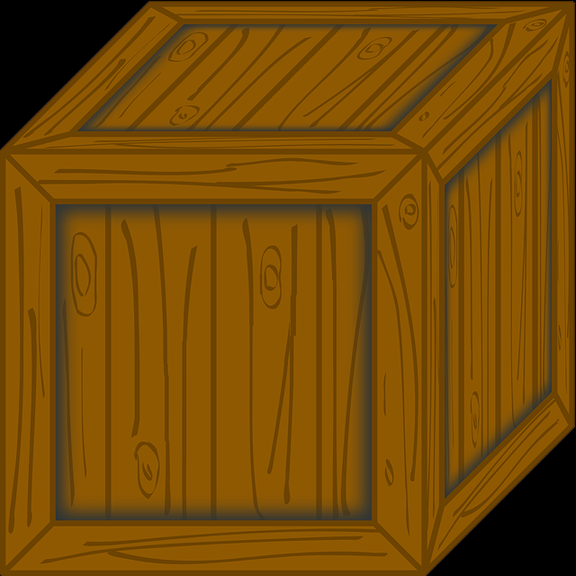
main() has a list called myList
Instead of copying over all of the values stored in myList, Python will instead pass a reference to newFxn()
myList
main()
newFxn()
Images from pixabay.com and flickr.com
Notes:
https://pixabay.com/en/box-crate-moving-package-wooden-41658/
https://pixabay.com/en/coconut-tree-palm-tree-dune-tree-1892861/
https://www.flickr.com/photos/39736050@N02/6883486850

Slide 35
main() has a list called myList
Instead of copying over all of the values stored in myList, Python will instead pass a reference to newFxn()
But now newFxn() has direct access to the actual contents of myList
myList
main()
newFxn()
Images from pixabay.com and flickr.com
Notes:
https://pixabay.com/en/box-crate-moving-package-wooden-41658/
https://pixabay.com/en/coconut-tree-palm-tree-dune-tree-1892861/
https://www.flickr.com/photos/39736050@N02/6883486850

Slide 36
Mutability in Functions
When a parameter is passed that is mutable, it is now possible for the second function to directly access and change the contents
This only works if we change the variable “in place” – assigning a whole new value to the variable will override the mutability
Any “in place” changes that are made to the shallow copy show up in the “original” list

Slide 37
Scope and Mutability in Functions
A good general rule for if a change is “in place”:
When you use something like .append() on it, that’s an “in place” change
When you use the assignment operator, the that’s not an “in place” change
Unless you are editing one element, like in a list

Slide 38
Scope and Mutability in Functions
Function is called, and formal parameter F
is assigned the actual parameter A
A is immutable
(integer, string)
A is mutable
(lists)
F is assigned to something else
F = [0, 1]
F = "hello"
F is modified in place
F.append(2)
F[0] = 17
A doesn’t change
If F changes
A doesn’t change
If F changes
A changes
If F changes
From http://stackoverflow.com/a/25670170

Slide 39
Using Mutability
Shallow copies are not always a bad thing!
Being able to
Pass a list to a function
Have that function make changes
And have those changes “stick”
Can be very useful!

Slide 40
LIVECODING!!!

Slide 41
Cloning and Adopting Dogs
Write a program that contains the following:
A main() with a list of dogs at an adoption event
Use deep copy to “clone” the dogs by creating a second, unique list (and a third one as well)
An adopt() function that takes in a list of dogs, and replaces all of their names with “adopted!”
These changes should “stick” in main() as well, without the function returning anything

Slide 42
Announcements
HW 5 out on Blackboard Wednesday night
Must re-take the Academic Integrity Quiz to see it
Due next Friday, April 7th @ 8:59:59 PM
Discussions start again next week
Remainder of labs will be in-person
Pre Lab quiz will come out Friday morning
Exam pick-up at the front

